Slide 1
The Technology Value Stream
Jacob Cannamela
CSD-380
5/31/2025

Slide 2
Setting the Stage – Why Lead Time and Processing Time Matter
I once waited three months for a feature update on a banking app, only to see it fail on launch day. That experience stuck with me. It made me curious about how workflows from an idea to a customer’s hands. In the technology value stream, we focus on two key ideas: Lead Time and Processing Time. Lead Time is how long a customer waits to get their request fulfilled. Processing Time is just the time spent actively working on that request. It’s a small distinction, but it has huge consequences.

Slide 3

Everyday Frustrations in Deployment Lead Times
Long lead times are more than just an inconvenience. They create a system where teams work in isolation, hoping their work will fit together at the end. This is the common scenario: months-long deployments that end in weekend fire drills, rollbacks, and missed deadlines. On page 10 of the DevOps Handbook, this scenario is described as typical in traditional IT. Slow, fragile, and stressful for everyone.

Slide 4
The Hidden Waste in Lead Time
Lead Time includes all the waiting: waiting for approvals, for testing, for someone else to finish their piece. Processing Time is what we do coding, testing, deploying. But it’s the lead time that defines the customer’s experience. Like a traffic jam, all that waiting can feel invisible but it’s the real problem. When lead time is too long, it doesn’t matter how efficient we are during the process time, it still feels slow and unresponsive.

Slide 5
My DevOps Dream – Deployment in Minutes
Here’s my personal vision: a world where my code goes live in minutes, not months. The DevOps Handbook says that in high-performing teams, deployment lead time drops to minutes. This is possible because of automated testing, modular design, and continuous deployment. When lead times are measured in minutes, we get faster feedback and lower risk, making life better for developers and customers.

Slide 6
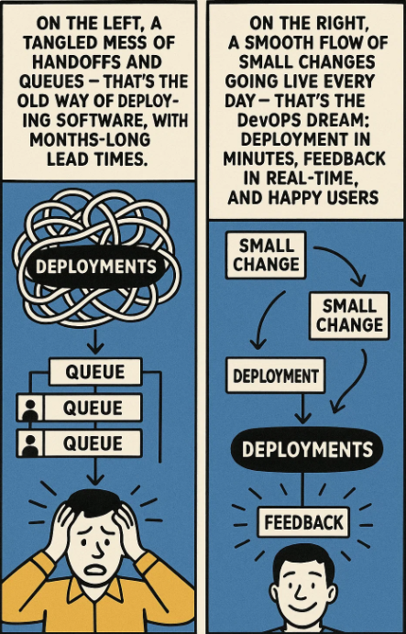
A Visual Story – Then vs. Now
On the left, a tangled mess of handoffs and queues – that’s the old way of deploying software, with months-long lead times. On the right, a smooth flow of small changes going live every day – that’s the DevOps dream: deployment in minutes, feedback in real-time, and happy users.

Slide 7
My Takeaway – The Human Cost
I’ve learned that lead time isn’t just about technology—it’s about people. When deployment takes months, developers burn out and customers lose trust. But when we shrink lead times to minutes, developers feel empowered, and customers get the features they want faster. Lead time shapes more than just the product—it shapes the culture.

Slide 8
Key Lessons I’ll Carry Forward
Here’s what I’ll take with me:
Work in small batches.
Build fast feedback into everything.
Learn from mistakes, not fear them. DevOps isn’t just about fancy tools; it’s about changing how we think and work together. That’s the part that excites me the most.

Slide 9
References
Kim, G., Humble, J., Debois, P., & Willis, J. (2016). The DevOps Handbook: How to Create World-Class Agility, Reliability, & Security in Technology Organizations. IT Revolution Press.
Beal, H. (n.d.). What is a Value Stream? https://www.vsmconsortium.org/blog/what-is-a-value-stream

